Slide 1
Module 1: Lesson 1 – Introduction to GPS

Slide 2
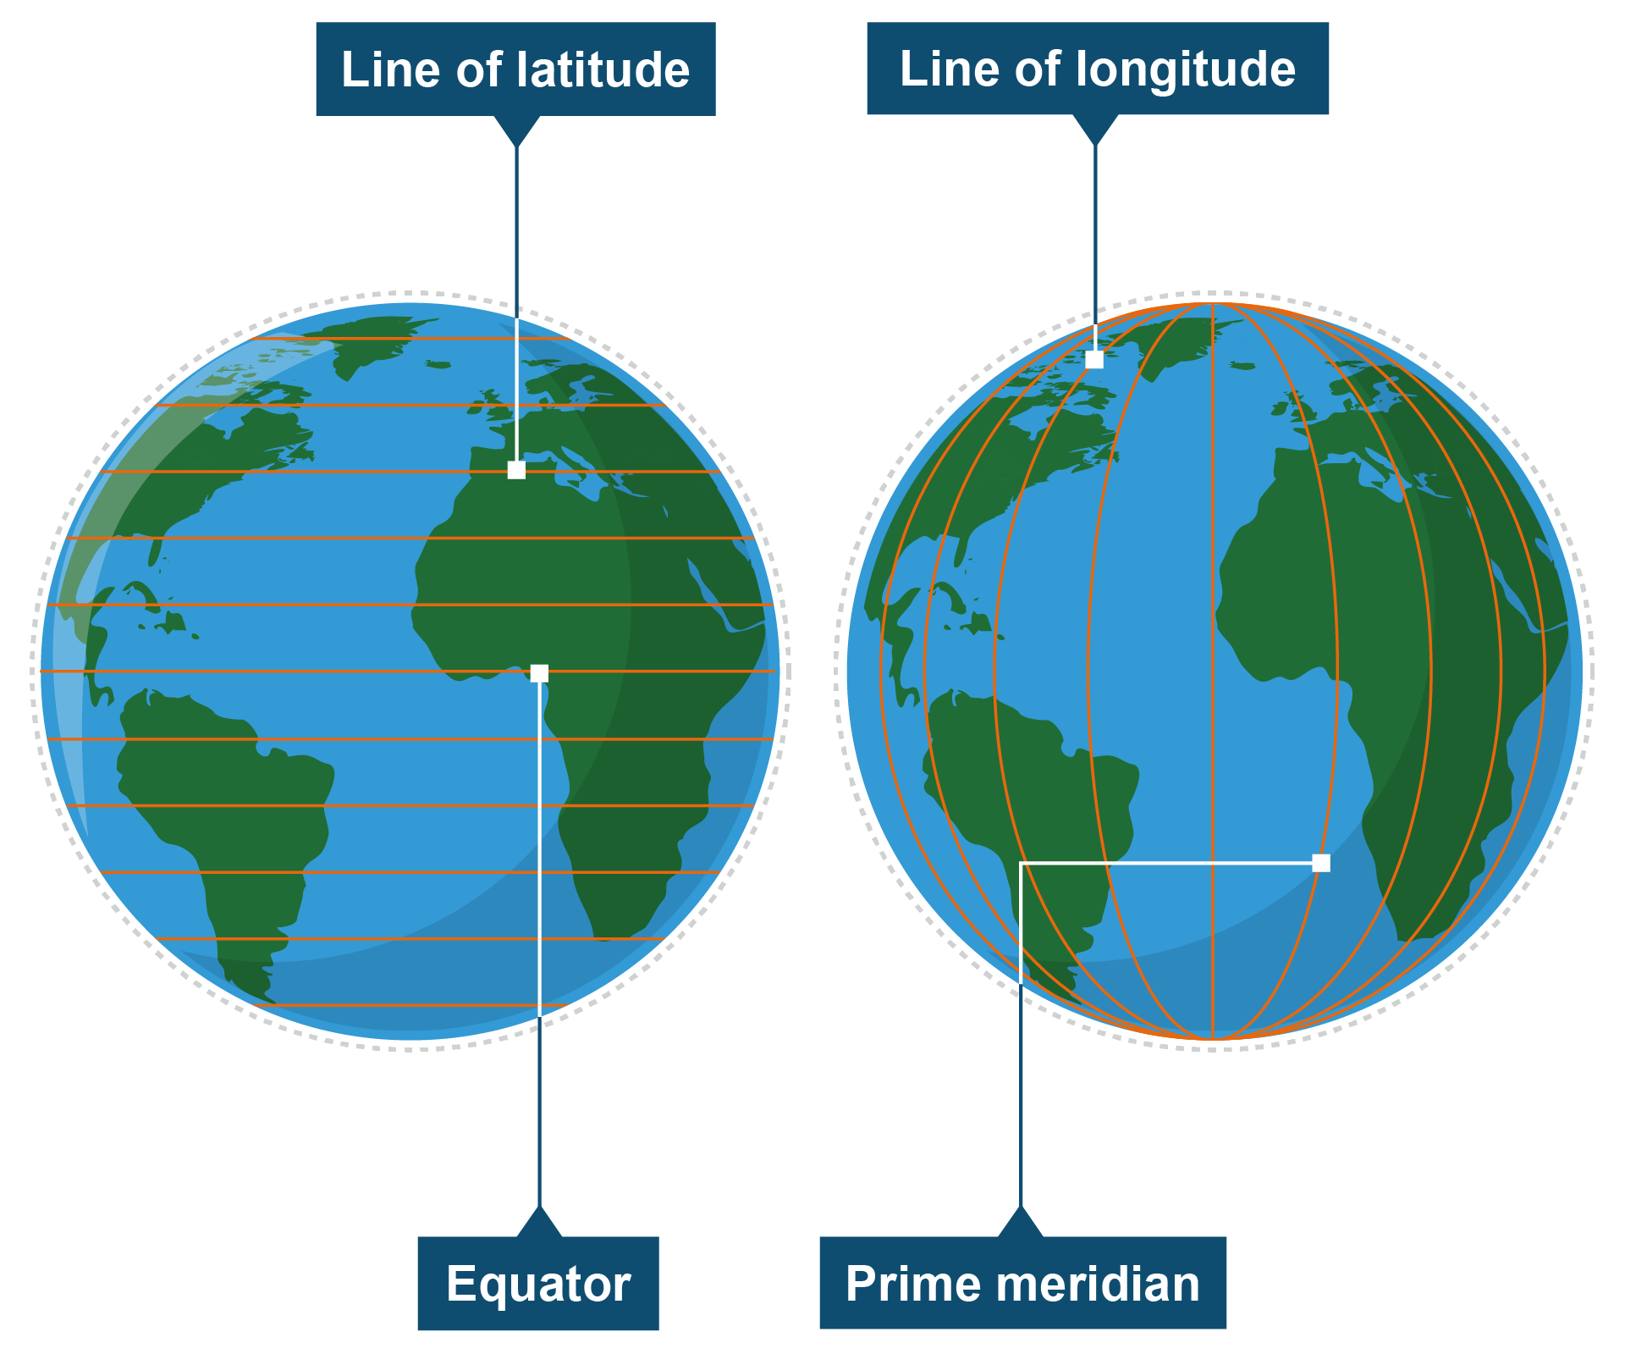
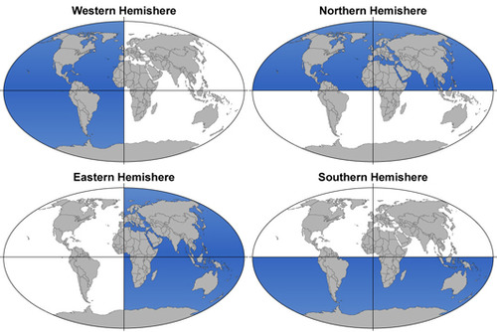

Spatial Positioning background
- Longitude W
+ Latitude N
+ Longitude E
- Latitude S
Notes:
We are going to start with some basic review of some geography terminology. The goal of GPS is to identify where we are on the earth, and we can use that for a lot of different reasons. We can use that to track a crop yield at a certain location or use our current location to help us guide a machine to somewhere we want to go.
Our place on the earth is defined by our latitude and longitude. Latitude are lines the run parallel to the equator. They run east to west around the globe. Lines of longitude run through the poles, north to south.
The sign (positive or negative) on the value of a latitude or longitude depends on what hemisphere we are in. For example, we will have a negative longitude in the western hemisphere and a positive longitude in the eastern hemisphere. Similarly, in the northern hemisphere, we will have a positive latitude and in the southern hemisphere, we will have a negative latitude.

Slide 3
Spatial Positioning background
(Lat, Long)
A. 42.0267567,-93.6170448
B. 42.0267567,93.6170448
- Longitude W
+ Latitude N
+ Longitude E
- Latitude S
Notes:
Listed are two sets of GPS coordinates. One is for Ames, Iowa and the other is in a district of China. Have the students figure out which one is which. Latitude always precedes Longitude
A = Ames, B= China

Slide 4
Global Navigation Satellite Systems
GNSS (Global Navigation Satellite Systems) is any satellite based positioning system used to pinpoint the geographic location of a receiver anywhere in the world
USA = Global Positioning Systems (GPS)
China = BeiDou Navigation Satellite System (BDS)
European Union = Galileo
Russia = GLONASS
Japan = Quasi-Zenith satellite system (QZSS)
Notes:
We often use “GPS” as a generic term to refer to any satellite-based positioning system, however, a more appropriate term would we GNSS (global navigation satellite systems). GPS is simply the USA based version of a GNSS.
While the GPS systems does cover the entire globe, other countries also have their own GNSS systems.

Slide 5
How many uses for GPS can you think of?
Notes:
Ask the Students:
As a group, how many uses of GPS can you think of? (have the students write answers on the board or just say them out loud)
Possible answers:
Real-Time Navigation (Vehicles & Travel) – Provides turn-by-turn directions, traffic updates, and ETAs for cars, trucks, buses, etc.
Public Transport Tracking – Monitors buses and trains for accurate schedules and passenger information.
Fleet Management & Logistics – Tracks delivery vehicles, optimizes routes, and improves supply chain efficiency.
Personal & Recreational Use – Powers smartphone mapping, fitness trackers, and outdoor activities like hiking or geocaching.
Surveying & Construction – Assists in land surveying, mapping, and guiding construction machinery for greater accuracy.
Livestock Tracking & Pasture Management – Uses GPS collars/tags to monitor animal locations and manage grazing rotations effectively.
Automated Irrigation Systems – Integrates GPS with moisture/weather data to schedule and control watering precisely.
Precision Agriculture – Guides tractors, automates seed/fertilizer distribution, and enhances overall field efficiency.
Crop Scouting & Disease Monitoring – Uses GPS-equipped drones/vehicles to identify pest infestations and disease outbreaks for targeted interventions.
Greenhouse & Orchard Management – Maps orchard layouts, monitors greenhouse environments, and coordinates harvesting.
Agricultural Drones for Spraying & Seeding – Employs GPS guidance for precise application of pesticides, herbicides, and seeds.
Emergency & Safety – Pinpoints 911 (or 112/999) caller locations, aids in search-and-rescue operations, and coordinates disaster relief.
Timing & Synchronization – Provides ultra-accurate timestamps for power grid management, telecommunications, and financial transactions.
Military & Defense – Guides military vehicles, supports secure operations, and enables precision in weapons targeting.

Slide 6
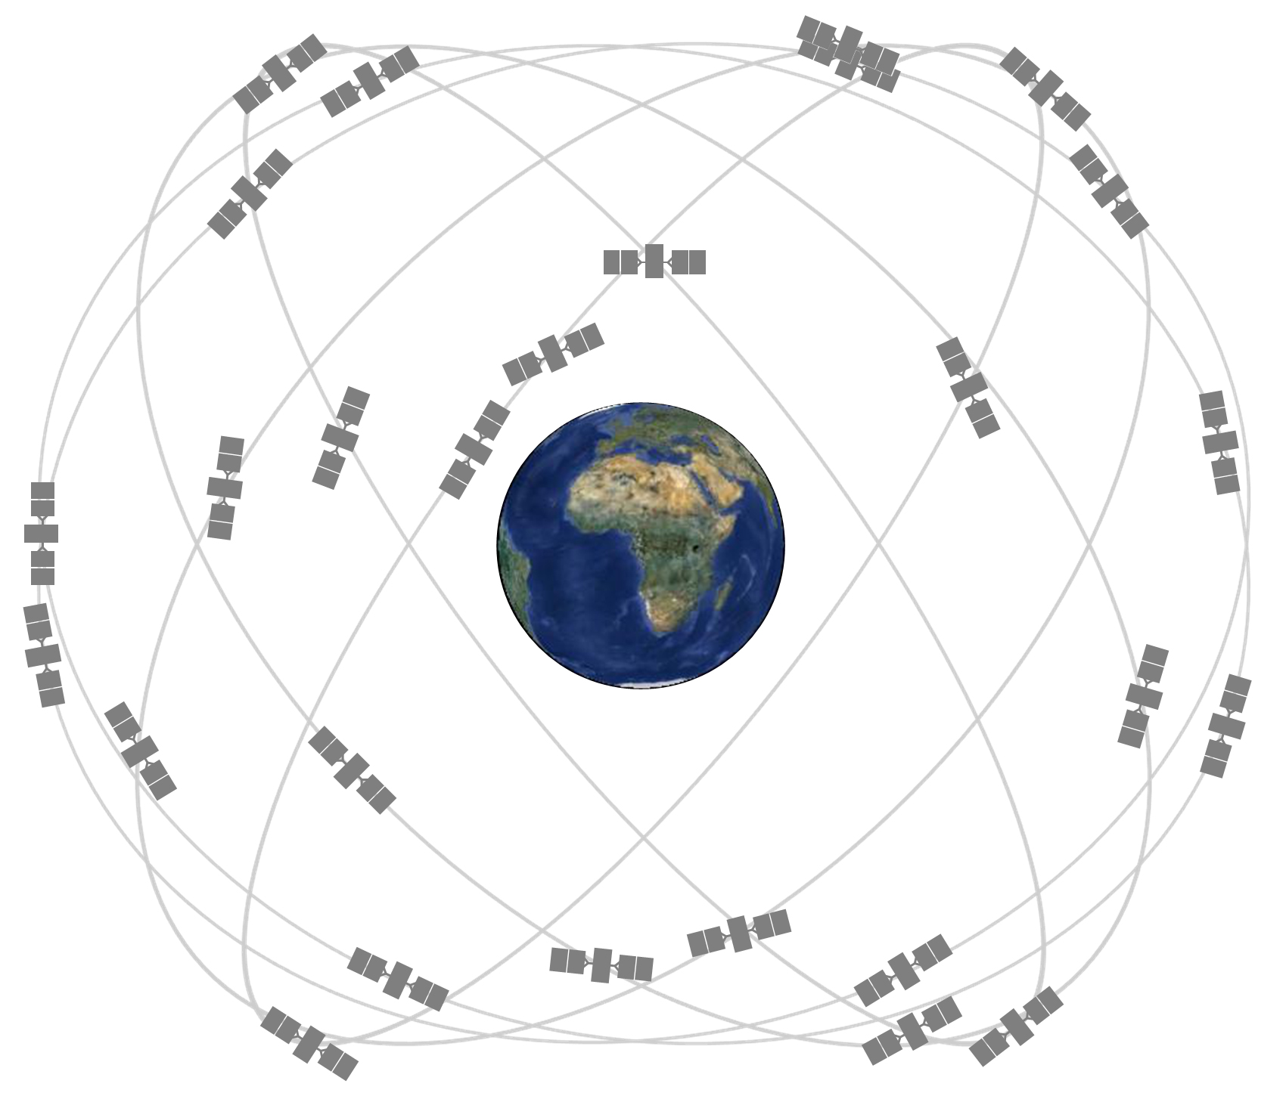
GPS Specifications
24 operational US satellites (plus a few spares)
Old satellites are replaced periodically
Satellites fly at an altitude of around 12,000 miles
Each satellite circles the earth twice a day
We need at least 4 satellites to pinpoint a location on earth
Notes:
The GPS system consists of a constellation of satellites transmitting radio signals down to earth. The united states has committed to maintaining the availability of at least 24 operational GPS satellites for 95% of the time. To fulfill this commitment, the United States government has been flying at least 31 operational GPS satellites for well over a decade.
For agricultural applications, we can use the GPS satellites in addition to other GNSS systems (GLONAAS, Galileo etc.) for a quicker and more accurate location identification. It is always better to have more satellites (faster and more accurate information)

Slide 7
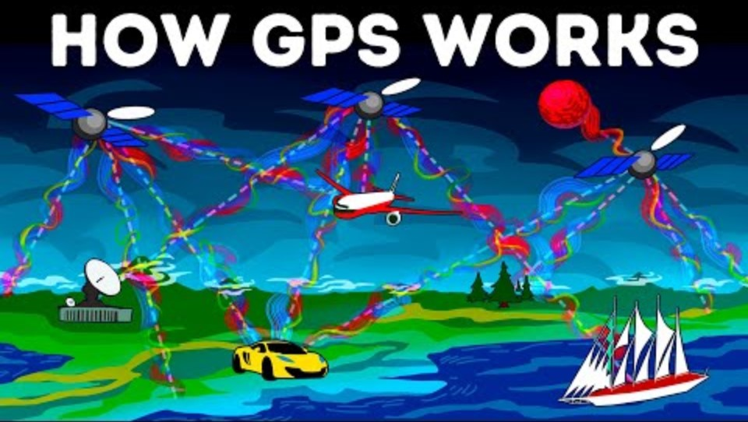
Notes:
This is a brief video explaining the origin of the GPS system and how it works.
Feel free to stop the video around the 8 minute mark

Slide 8
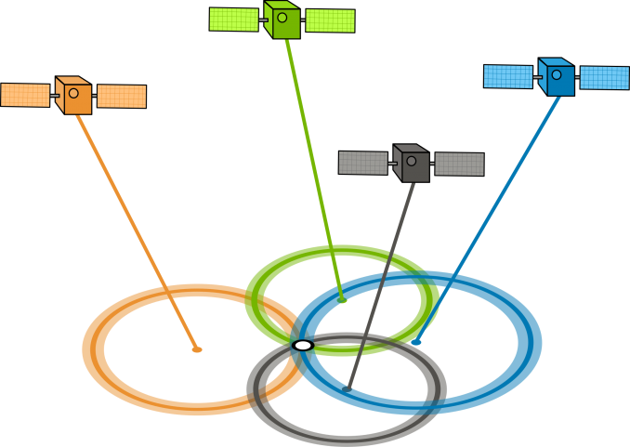
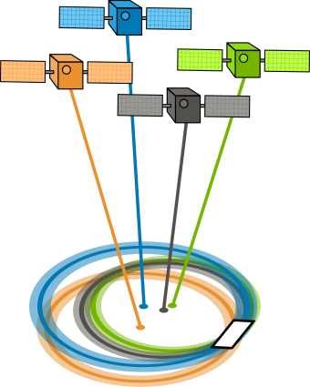
GPS Accuracy

Slide 9
